Slide 1
Data Mining:
Concepts and Techniques
(3rd ed.)
— Chapter 3 —
Jiawei Han, Micheline Kamber, and Jian Pei
University of Illinois at Urbana-Champaign &
Simon Fraser University
©2011 Han, Kamber & Pei. All rights reserved.

Slide 2
Chapter 3: Data Preprocessing
Data Preprocessing: An Overview
  Data Quality
Major Tasks in Data Preprocessing
  Data Cleaning
  Data Integration
  Data Reduction
  Data Transformation and Data Discretization
Summary

Slide 3
Data Quality: Why Preprocess the Data?
Measures for data quality: A multidimensional view
  Accuracy: correct or wrong, accurate or not
  Completeness: not recorded, unavailable, …
  Consistency: some modified but some not, dangling, …
  Timeliness: timely update?
  Believability: how trustable the data are correct?
  Interpretability: how easily the data can be understood?

Slide 4
Major Tasks in Data Preprocessing
Data cleaning
  Fill in missing values, smooth noisy data, identify or remove outliers, and resolve inconsistencies
Data integration
  Integration of multiple databases, data cubes, or files
Data reduction
  Dimensionality reduction
  Numerosity reduction
  Data compression
Data transformation and data discretization
  Normalization
  Concept hierarchy generation

Slide 5
Chapter 3: Data Preprocessing
Data Preprocessing: An Overview
  Data Quality
  Major Tasks in Data Preprocessing
Data Cleaning
Data Integration
Data Reduction
Data Transformation and Data Discretization
Summary

Slide 6
Data Cleaning
Why it’s important
  “Garbage in, garbage out”
  poor quality data → poor model performance.
  Data cleaning can take up 60–80% of a data scientist’s time.
Sources of dirty data:
  Manual entry errors
  Sensor/collection faults
  Missing logging events
  Data merging from multiple sources

Slide 7
Data Cleaning
Data in the real world might be
  incomplete: lacking attribute values, lacking certain attributes of interest, or containing only aggregate data
    e.g., Occupation=“ ” (missing data)
  noisy: containing noise, errors, or outliers
    e.g., Salary=“−10” (an error)
  inconsistent: containing discrepancies in codes or names, e.g.,
    Age=“42”, Birthday=“03/07/2010”
    Was rating “1, 2, 3”, now rating “A, B, C”
    discrepancy between duplicate records
  Intentional (e.g., disguised missing data)
    Jan. 1 as everyone’s birthday?

Slide 8
How to Handle Missing Data?
A. Removing missing data
dropna() in pandas
When appropriate: if missing percentage is very high or the column is not useful
B. Imputation techniques
1. Simple Imputation
Numerical: mean, median, mode
Categorical: mode or “Unknown” label
2. Conditional Imputation
Using grouped statistics
Example: fill missing salary by median salary within the same department
3. Interpolation
Linear interpolation for time series data
4. Advanced Imputation
Predict missing values using ML (e.g., KNN imputer, regression)

Slide 9
Chapter 3: Data Preprocessing
Data Preprocessing: An Overview
  Data Quality
  Major Tasks in Data Preprocessing
Data Cleaning
Data Integration
Data Reduction
Data Transformation and Data Discretization
Summary

Slide 10
Data Integration
What is data integration?
  Combining data from multiple sources into a unified, consistent view.
Why it’s important:
  Many projects rely on data from different files, databases, APIs, sensors, or organizations.

Slide 11
Challenges in Data Integration
Schema Integration – Different sources may have:
  Different column names for the same concept (e.g., cust_id vs. customer_id).
  Different data formats (e.g., dates in YYYY-MM-DD vs. DD/MM/YYYY).
  Different data types (e.g., string vs. integer IDs).
Entity Identification Problem – Matching records that refer to the same entity but look different (e.g., "Rahim Dehkharghani" vs. "R. Dehkharghani").
Data Redundancy & Duplication – Same data repeated across sources.
Data Value Conflicts – Different sources give different values for the same attribute (e.g., different phone numbers).
Scalability – Integrating large datasets efficiently.

Slide 12
Handling Redundancy in Data Integration
Redundant data occur often when integration of multiple databases
  Object identification: The same attribute or object may have different names in different databases
  Derivable data: One attribute may be a “derived” attribute in another table, e.g., annual revenue
Redundant attributes may be able to be detected by correlation analysis and covariance analysis
Careful integration of the data from multiple sources may help reduce/avoid redundancies and inconsistencies and improve mining speed and quality

Slide 13
Handling Redundancy in Data Integration
Redundant data occur often when integration of multiple databases
  Object identification: The same attribute or object may have different names in different databases
  Derivable data: One attribute may be a “derived” attribute in another table, e.g., annual revenue
Redundant attributes may be able to be detected by correlation analysis and covariance analysis
Careful integration of the data from multiple sources may help reduce/avoid redundancies and inconsistencies and improve mining speed and quality

Slide 14

Visually Evaluating Correlation
Scatter plots showing the similarity from –1 to 1.

Slide 15
Covariance (Numeric Data)
Correlation Coefficient
Measures the strength and direction of a linear relationship.
Common measure: Pearson’s correlation (values between -1 and 1).
  +1 → perfect positive relationship.
  -1 → perfect negative relationship.
  0 → no linear relationship.

Slide 16
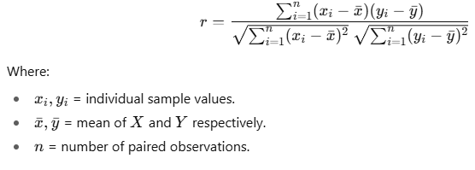
Pearson correlation coefficient
The Pearson correlation coefficient rrr measures the strength and direction of a linear relationship between two variables X and Y.

Slide 17
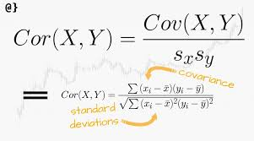
Co-Variance vs Correlation Coefficient

Slide 18

Co-Variance: An Example
It can be simplified in computation as
Suppose two stocks A and B have the following values in one week: (2, 5), (3, 8), (5, 10), (4, 11), (6, 14).
Question: If the stocks are affected by the same industry trends, will their prices rise or fall together?
  E(A) = (2 + 3 + 5 + 4 + 6)/ 5 = 20/5 = 4
  E(B) = (5 + 8 + 10 + 11 + 14) /5 = 48/5 = 9.6
  Cov(A,B) = (2×5+3×8+5×10+4×11+6×14)/5 − 4 × 9.6 = 4
Thus, A and B rise together since Cov(A, B) > 0.

Slide 19
Chapter 3: Data Preprocessing
Data Preprocessing: An Overview
  Data Quality
  Major Tasks in Data Preprocessing
Data Cleaning
Data Integration
Data Reduction
Data Transformation and Data Discretization
Summary

Slide 20
Data Reduction Strategies
Data reduction: Obtain a reduced representation of the data set that is much smaller in volume but yet produces the same (or almost the same) analytical results
Why data reduction? — A database/data warehouse may store terabytes of data. Complex data analysis may take a very long time to run on the complete data set.
Data reduction strategies
  Dimensionality reduction, e.g., remove unimportant attributes
    Wavelet transforms
    Principal Components Analysis (PCA)
    Feature subset selection, feature creation
  Numerosity reduction (some simply call it: Data Reduction)
    Regression and Log-Linear Models
    Histograms, clustering, sampling
    Data cube aggregation
  Data compression

Slide 21
Data Reduction 1: Dimensionality Reduction
Curse of dimensionality
  When dimensionality increases, data becomes increasingly sparse
  The error increases with the increase in the number of features.
  Density and distance between points, which is critical to clustering, outlier analysis, becomes less meaningful
  The possible combinations of subspaces will grow exponentially
Dimensionality reduction
  Avoid the curse of dimensionality
  Help eliminate irrelevant features and reduce noise
  Reduce time and space required in data mining
  Allow easier visualization
Dimensionality reduction techniques
  Wavelet transforms
  Principal Component Analysis
  Supervised and nonlinear techniques (e.g., feature selection)

Slide 22
Principal Component Analysis (PCA)
Find a projection that captures the largest amount of variation in data
The original data are projected onto a much smaller space, resulting in dimensionality reduction. We find the eigenvectors of the covariance matrix, and these eigenvectors define the new space
Think of PCA like taking a picture of a 3D object from the best angle so you capture as much detail as possible in a flat 2D image.
x₂
e
x₁

Slide 23
Principal Component Analysis (Steps)
Given N data vectors from n-dimensions, find k ≤ n orthogonal vectors (principal components) that can be best used to represent data
  Normalize input data: Each attribute falls within the same range
  Compute k orthonormal (unit) vectors, i.e., principal components
  Each input data (vector) is a linear combination of the k principal component vectors
  The principal components are sorted in order of decreasing “significance” or strength
  Since the components are sorted, the size of the data can be reduced by eliminating the weak components, i.e., those with low variance (i.e., using the strongest principal components, it is possible to reconstruct a good approximation of the original data)
Works for numeric data only

Slide 24
Principal Component Analysis (PCA)
Steps of PCA (simple version)
Standardize the data (so all features are on the same scale)
Find the covariance matrix (measures how variables change together)
Find eigenvalues and eigenvectors (these tell us the directions of maximum variance)
Sort eigenvalues (largest first) → keep top kkk components
Transform the data to the new coordinates (principal components)

Slide 25
PCA formulation

Slide 26
PCA formulation

Slide 27
PCA formulation

Slide 28
Principal Component Analysis (PCA)
Steps of PCA (simple version)
Standardize the data (so all features are on the same scale)
Find the covariance matrix (measures how variables change together)
Find eigenvalues and eigenvectors (these tell us the directions of maximum variance)
Sort eigenvalues (largest first) → keep top kkk components
Transform the data to the new coordinates (principal components)

Slide 29
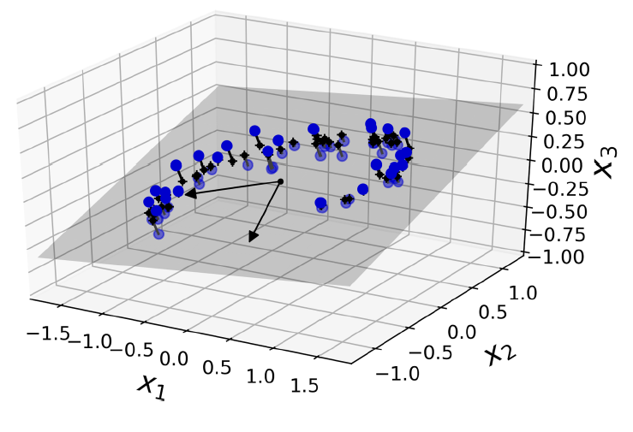
Projection
Mapping data from a high dimension to a lower dimension
Reduce from 3 to 2-dimensional space

Slide 30
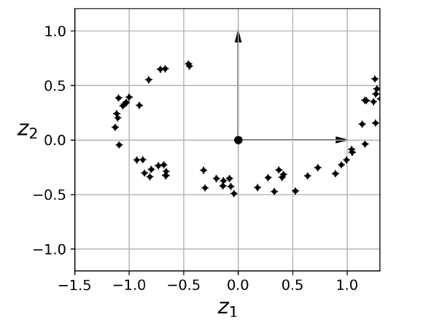
Projection
Reduce from 3 to 2-dimensional space

Slide 31
Principal Component Analysis (PCA)
Watch this video for better understanding:
https://www.youtube.com/watch?v=FgakZw6K1QQ&ab_channel=StatQuestwithJoshStarmer

Slide 32
Attribute Subset Selection
Another way to reduce dimensionality of data
Redundant attributes
  Duplicate much or all of the information contained in one or more other attributes
  E.g., purchase price of a product and the amount of sales tax paid
Irrelevant attributes
  Contain no information that is useful for the data mining task at hand
  E.g., students' ID is often irrelevant to the task of predicting students' GPA

Slide 33
Heuristic Search in Attribute Selection
There are 2^{d} possible attribute combinations of d attributes
Typical heuristic attribute selection methods:
  Best single attribute under the attribute independence assumption: choose by significance tests
  Best step-wise feature selection:
    The best single-attribute is picked first
    Then next best attribute condition to the first, ...
  Step-wise attribute elimination:
    Repeatedly eliminate the worst attribute
  Best combined attribute selection and elimination
  Optimal branch and bound:
    Use attribute elimination and backtracking

Slide 34
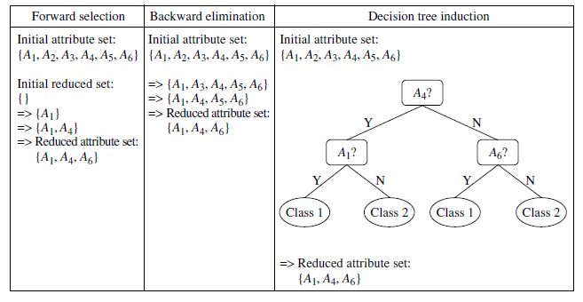
Attribute Selection

Slide 35
PCA versus feature subset selection
In PCA, the whole feature set is mapped to a much smaller set, Where K<<N
But in feature subset selection, a subset of feature which achieve the best performance is selected.
Unlike attribute subset selection, which reduces the attribute set size by retaining a subset of the initial set of attributes, PCA “combines” the essence of attributes by creating an alternative,
smaller set of variables.
F1, F2, …., Fn
G1, …., Gk
F1, F2, …, Fn
F2, F5, F7…

Slide 36
Data Reduction 2: Numerosity Reduction
Reduce data volume by choosing alternative, smaller forms of data representation
Parametric methods (e.g., regression)
  Assume the data fits some model, estimate model parameters, store only the parameters, and discard the data (except possible outliers)
  Ex.: Log-linear models—n obtain value at a point in m-D space as the product appropriate marginal subspaces
Non-parametric methods
  Do not assume models
  Major families: histograms, clustering, sampling, …

Slide 37
Parametric Data Reduction: Regression and Log-Linear Models
Linear regression
  Data modeled to fit a straight line
  Often uses the least-square method to fit the line
Multiple regression
  Allows a response variable Y to be modeled as a linear function of multidimensional feature vector
Log-linear model
  Approximates discrete multidimensional probability distributions

Slide 38
Regression Analysis
y
Y1
Regression analysis: A collective name for techniques for the modeling and analysis of numerical data consisting of values of a dependent variable (also called response variable or measurement) and of one or more independent variables (aka. explanatory variables or predictors)
The parameters are estimated so as to give a "best fit" of the data
Most commonly the best fit is evaluated by using the least squares method, but other criteria have also been used
Y1’
y = x + 1
X1
x
Used for prediction (including forecasting of time-series data), inference, hypothesis testing, and modeling of causal relationships

Slide 39
Regress Analysis and Log-Linear Models
Linear regression: Y = w X + b
  Two regression coefficients, w and b, specify the line and are to be estimated by using the data at hand
  Using the least squares criterion to the known values of Y₁, Y₂, …, X₁, X₂, ….
Multiple regression: Y = b₀ + b₁ X₁ + b₂ X₂
  Many nonlinear functions can be transformed into the above
Log-linear models: LnY = b₀ + b₁ X₁
  Approximate discrete multidimensional probability distributions
  Estimate the probability of each point (tuple) in a multi-dimensional space for a set of discretized attributes, based on a smaller subset of dimensional combinations
  Useful for dimensionality reduction and data smoothing

Slide 40
Non-parametric methods
  Do not assume models
  Major families: histograms, clustering, sampling, …

Slide 41
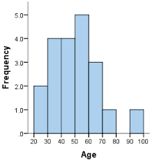
Histogram Analysis
Divide data into buckets and store average (sum) for each bucket
Partitioning rules:
  Equal-width: equal bucket range
  Equal-frequency (or equal-depth)

Slide 42
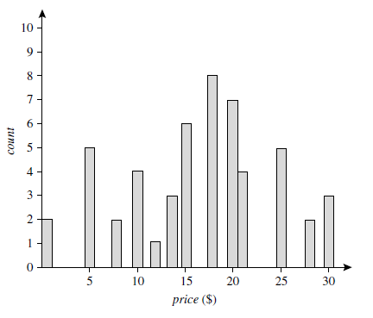
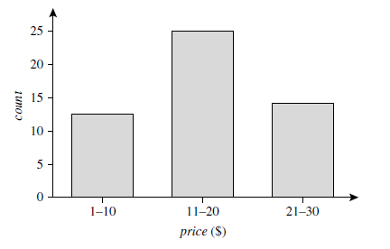
Histogram Example
The following data are a list of AllElectronics prices for commonly sold
items (rounded to the nearest dollar). The numbers have been sorted: 1, 1, 5, 5, 5,
5, 5, 8, 8, 10, 10, 10, 10, 12, 14, 14, 14, 15, 15, 15, 15, 15, 15, 18, 18, 18, 18, 18,
18, 18, 18, 20, 20, 20, 20, 20, 20, 20, 21, 21, 21, 21, 25, 25, 25, 25, 25, 28, 28, 30,
30, 30.

Slide 43
Clustering
Partition data set into clusters based on similarity, and store cluster representation (e.g., centroid and diameter) only
Can be very effective if data are clustered but not if data are “smeared”
Can have hierarchical clustering and be stored in multi-dimensional index tree structures
There are many choices of clustering definitions and clustering algorithms
Cluster analysis will be studied in depth in Chapter 10

Slide 44
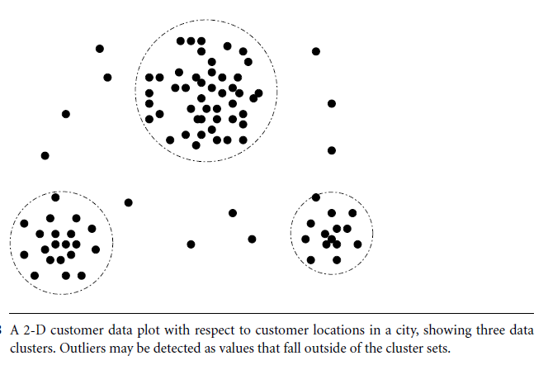
Clustering
Cluster centroids can be stored instead of all data points

Slide 45
Sampling
Sampling: obtaining a small sample s to represent the whole data set N
Allow a mining algorithm to run in complexity that is potentially sub-linear to the size of the data
Key principle: Choose a representative subset of the data
  Simple random sampling may have very poor performance in the presence of skew
  Develop adaptive sampling methods, e.g., stratified sampling:
Note: Sampling may not reduce database I/Os (page at a time)

Slide 46
Types of Sampling
Simple random sampling
  There is an equal probability of selecting any particular item
Sampling without replacement
  Once an object is selected, it is removed from the population
Sampling with replacement
  A selected object is not removed from the population
Stratified sampling:
  Partition the data set, and draw samples from each partition (proportionally, i.e., approximately the same percentage of the data)
  Used in conjunction with skewed data

Slide 47
Sampling: With or without Replacement
SRSWOR
(simple random
sample without
replacement)
SRSWR
Raw Data

Slide 48
Sampling: Cluster or Stratified Sampling
Raw Data
Cluster/Stratified Sample

Slide 49
Chapter 3: Data Preprocessing
Data Preprocessing: An Overview
  Data Quality
  Major Tasks in Data Preprocessing
Data Cleaning
Data Integration
Data Reduction
Data Transformation and Data Discretization
Summary

Slide 50
Data Transformation
A function that maps the entire set of values of a given attribute to a new set of replacement values s.t. each old value can be identified with one of the new values
Methods
  Smoothing: Remove noise from data
  Attribute/feature construction
    New attributes constructed from the given ones
  Aggregation: Summarization, data cube construction
  Normalization: Scaled to fall within a smaller, specified range
    min-max normalization
    z-score normalization
    normalization by decimal scaling
  Discretization: Concept hierarchy climbing

Slide 51





Normalization
Min-max normalization: to [new_min_{A}, new_max_{A}]
  Ex. Let income range $12,000 to $98,000 normalized to [0.0, 1.0]. Then $73,600 is mapped to
Z-score normalization (μ: mean, σ: standard deviation):
  Ex. Let μ = 54,000, σ = 16,000. Then
Normalization by decimal scaling
Where j is the smallest integer such that Max(|ν’|) < 1

Slide 52
Chapter 3: Data Preprocessing
Data Preprocessing: An Overview
  Data Quality
  Major Tasks in Data Preprocessing
Data Cleaning
Data Integration
Data Reduction
Data Transformation and Data Discretization
Summary

Slide 53
Summary
Data quality: accuracy, completeness, consistency, timeliness, believability, interpretability
Data cleaning: e.g. missing/noisy values, outliers
Data integration from multiple sources:
  Entity identification problem
  Remove redundancies
  Detect inconsistencies
Data reduction
  Dimensionality reduction
  Numerosity reduction
  Data compression
Data transformation and data discretization
  Normalization
  Concept hierarchy generation

